Slide 1
Corobatch
Batch operations, simply, with coroutines
Francesco Zoffoli
C++ Meetup London - 18th May 2020
makers.f.dev@gmail.com
github.com/MakersF
Notes:
Hello everyone!
It’s nice to be here. Unusual situation for everyone, but it’s nice that we can still share our passion for C++
I’m Francesco Zoffoli, and today we are going to explore
Corobatch, how to batch operation,simply. using coroutines
Along the talk I’ll stop several times to give a chance to ask questions. There is also the live chat on youtube where you can write your questions and any comment you have
Let’s get started

Slide 2
Presentation
The Problem
An idea to solve it
Coroutines in C++20
How to implement the idea with coroutines
Conclusion
Notes:
Take away
If you know coroutines: a cool application
If you don’t know coroutines: intuition of how they work in c++20

Slide 3
The Problem

Slide 4
The Problem
Batch operations tend to be better than single operations
Batch operation: processing multiple actions or data at once
Notes:
What is a batch operation?
No specific definition, but …

Slide 5
The Problem
Example of actions which benefit from being batch:
networking
file I/O
memory allocation
GPU draw calls
...
Common property:
cost = FixedCost + O(#operation/data)

Slide 6
The Problem
Networking latency
round trip ≫ data transfer
Write disk
disk seek ≫ data write
DB table scan
scan all records ≫ conditions to check per row
Notes:
What are other examples of operations that benefit from batching in your experience?
You can share it in the live chat

Slide 7
The Problem
Let’s analyse an example:
“Send a notification to a group of users, respecting their preferences”
Batch operations
fetching preferences
sending notifications
Notes:
Batch operation: take a vector, return a vector

Slide 8
Example - No Batching
for(const User& user : users) {
const UserPreferences preferences =
getUserPreferences({user.id}).at(0);
if (preferences.wantsEmailNotification) {
sendNotification({
preferences.notificationEmail
});
}
}
Notes:
Easy to read
We are not using batching!

Slide 9
The Problem
But batching is important!
Notes:
Let’s rewrite the code to use it

Slide 10
Example - Batching
vector<UserId> userIds;
transform(users.begin(), users.end(),
back_inserter(userIds),
[](const User& user) { return user.id; });
vector<UserPreferences> preferences =
getUserPreferences(userIds);
remove_if(preferences.begin(), preference.end(),
[](const UserPreferences& pref) {
return !pref.wantsEmailNotification;});
vector<UserEmail> emails;
transform(preferences.begin(), preference.end(),
back_inserter(emails),
[](const UserPreferences& pref) {
return pref.notificationEmail; });
sendNotification(emails);
Notes:
We are now batching, but it looks completely different from the original code.
The logic is there, but more effort is required to understand it
There is also a bug. Can you spot it?

Slide 11
Readability vs Performance
The code is significantly different
requires a lot of effort to understand it
extra memory used
cannot use const

Slide 12
Performance?
Performance is not a single number
throughput
latency
others: efficiency (work over resources usage), rate limit, cost
Different properties are important in different situations
Notes:
What we optimize for depends on the context, but batching can help in many of them

Slide 13
Questions?

Slide 14
The Idea

Slide 15
The Idea
Can we keep
the readability of the first code, and
the batching behaviour of the second?

Slide 16
The Idea
prefs = getUserPrefs(user.id);
if (prefs.notify) {
sendNotification(prefs.email);
}
User 1
Each user gets its own code block
The blocks can execute independently one from the other
prefs = getUserPrefs(user.id);
if (prefs.notify) {
sendNotification(prefs.email);
}
User 2
for(user : users) {
prefs = getUserPrefs(user.id);
if (prefs.notify) {
sendNotification(prefs.email);
}
}
prefs = getUserPrefs(user.id);
if (prefs.notify) {
sendNotification(prefs.email);
}
User 3
…
prefs = getUserPrefs(user.id);
if (prefs.notify) {
sendNotification(prefs.email);
}
User n
Notes:
What if we could gather all the parameters passed to a function when executing the loop before calling the function?

Slide 17
The Idea
prefs = getUserPrefs(user.id);
if (prefs.notify) {
sendNotification(prefs.email);
}
user.id
User 1
Batch
Operation
prefs = getUserPrefs(user.id);
if (prefs.notify) {
sendNotification(prefs.email);
}
user.id
User 2
prefs
prefs = getUserPrefs(user.id);
if (prefs.notify) {
sendNotification(prefs.email);
}
prefs
user.id
User 3
prefs
Result
Notes:
In the diagram, the red arrow is the current execution and the blue is where we suspended.
When the code hit getUserPrefs, it blocks execution and stores the parameter in the batch.
Then control is given to the next block.
When we have enough stored arguments, we execute the batch and get the result.

Slide 18
The Idea
prefs = getUserPrefs(user.id);
if (prefs.notify) {
sendNotification(prefs.email);
}
User 1
Batch
prefs = getUserPrefs(user.id);
if (prefs.notify) {
sendNotification(prefs.email);
}
User 2
prefs
prefs = getUserPrefs(user.id);
if (prefs.notify) {
sendNotification(prefs.email);
}
prefs
User 3
prefs
Result
Notes:
Then, we resume the code from where it blocked, returning the result for that user.
Execution continues, until it blocks again, and this process continues.

Slide 19
The Idea
Start executing until a batch operation is reached
Record the argument to that operation, and stop execution
If we did not record enough arguments, go to point 1 for a new input
Execute the batch operation
Resume the stopped executions with the results from the batch operation
Coroutines allow exactly that

Slide 20
Questions?

Slide 21
Coroutines

Slide 22
Coroutines
Resumable function
A coroutine can:
2 and 3 can happen many times
1. start
2. suspend and return control to the caller
executing
suspended
4. terminate
3. resume at the last suspension point

Slide 23
Coroutines in C++
Stackless
materialized object which contains all the required state
returns control directly to the caller
Two components: promise and handle
Promise: used from inside the coroutine
Handle: used from outside the coroutine
To be a coroutine a function must
use co_await and/or co_return
have a return type that defines a promise_type which satisfies a specific concept
NOTE: what is presented here is a subset of the C++20 coroutines

Slide 24
Coroutines in C++
How does a coroutine look like?
task my_coro() {
cout << "foo begin\n";
co_await async_operation();
co_return;
}

Slide 25
Coroutines in C++ - Handle

Slide 26
Coroutines in C++ - Handle
A handle
is a not owning pointer
points to coroutine state
its type is std::experimental::coroutine_handle<>
If you know the promise_type of the coroutine, you can use std::experimental::coroutine_handle<promise_type> as a type

Slide 27
Coroutines in C++ - Handle
The main methods are
resume(): resume the associated coroutine
destroy(): destroy the associated coroutine
In addition, when using coroutine_handle<promise_type>
promise(): return the promise associated with the coroutine
from_promise(promise&): static, create the handle from a promise

Slide 28
Coroutines in C++ - co_await

Slide 29
Coroutines in C++ - co_await
When a coroutine reaches co_await awaitable;
awaitable.await_ready() is called. If returns true, skip point 2 and 3
The coroutine is suspended
awaitable.await_suspend(handle) is called to schedule the handle to be resumed when the awaitable is ready
When the coroutine is resumed
awaitable.await_resume() is called, the result of the co_await expression is set to its return value
The body continues execution from the co_await expression

Slide 30
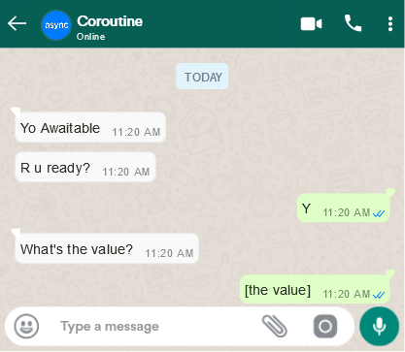
Coroutines in C++ - co_await
Notes:
No suspetion

Slide 31
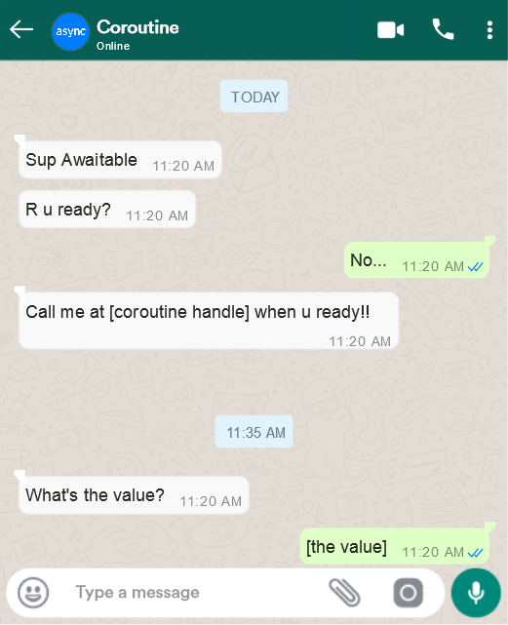
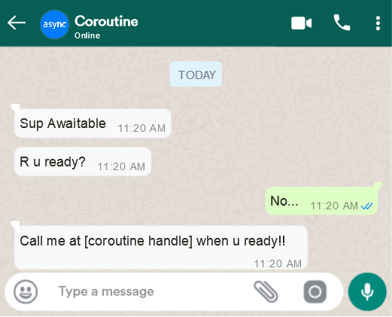
Coroutines in C++ - co_await
At 11:20
Awaitable tells executor to call [coroutine handle] when it’s ready
At 11:35
The operation completes, executor calls [couroutine handle] saying that awaitable is ready

Slide 32
Coroutines in C++ - Lifetime of a Promise

Slide 33
Coroutines in C++ - Lifetime of a Promise
When my_coro() is invoked
allocate space and construct the coroutine state
instantiate task::promise_type
call promise.get_return_object()
invoke co_await promise.initial_suspend()
when resumed, start executing the body
coroutine state
task
get_return_object()
promise
co_await
awaitable
initial_suspend()
Notes:
The coroutine state is the state required by the compiler to be able to suspend and resume the coroutine at the right points

Slide 34
Coroutines in C++ - Lifetime of a Promise
When the coroutine terminates
One of the following is called
promise.return_void() on co_return; or end of function
promise.return_value(ValueType) on co_return val;
promise.unhandled_exception() in case of exception
co_await promise.final_suspend()
The promise and the state of the coroutine is destroyed
Automatically if final_suspend did not suspend
Manually calling destroy() on the handle otherwise
All of the above is inserted by the compiler

Slide 35
Questions?

Slide 36
Coroutines in C++ - by Example
Let’s learn by example
implement an awaitable
implement a task
see control flow in a few code snippets

Slide 37
Coroutines in C++ - by Example
No-op awaitable
Template parameter to control whether it suspends
template<bool SUSPEND>
struct awaitable {
bool await_ready() { return !SUSPEND; }
void await_suspend(coroutine_handle<>) { }
void await_resume() { }
};

Slide 38
Coroutines in C++ - by Example
Task with handle to coroutine
Template parameter to control initial and final suspend behavior
template<bool INIT_SUSPEND, bool FINAL_SUSPEND>
struct task {
struct promise_type { … };
coroutine_handle<promise_type> handle_;.
};

Slide 39
Coroutines in C++ - by Example
template<bool INIT_SUSPEND, bool FINAL_SUSPEND>
struct task {
struct promise_type {
void unhandled_exception() { }
void return_void() { }
awaitable<INIT_SUSPEND> initial_suspend() { return {}; }
awaitable<FINAL_SUSPEND> final_suspend() { return {}; }
…
};
…
};

Slide 40
Coroutines in C++ - by Example
template<bool INIT_SUSPEND, bool FINAL_SUSPEND>
struct task {
struct promise_type {
…
task get_return_object() {
return {coroutine_handle<promise_type>::from_promise(*this)};
}
};
};

Slide 41
Questions?

Slide 42
Coroutines in C++ - by Example
task<NO_SUSPEND, NO_SUSPEND> foo() {
cout << "foo.0" << endl;
co_return;
}
int main() {
cout << "main.0" << endl;
task t = foo();
cout << "main.1" << endl;
}
main.0
promise_type
get_return_object
initial_suspend
await_ready -> True
await_resume
foo.0
return_void
final_suspend
await_ready -> True
await_resume
~promise_type
main.1

Slide 43
Coroutines in C++ - by Example
task<SUSPEND, NO_SUSPEND> foo() {
cout << "foo.0" << endl;
co_return;
}
int main() {
cout << "main.0" << endl;
task t = foo();
cout << "main.1" << endl;
t.handle_.resume();
cout << "main.2" << endl;
}
main.0
promise_type
get_return_object
initial_suspend
await_ready -> False
await_suspend
main.1
await_resume
foo.0
return_void
final_suspend
await_ready -> True
await_resume
~promise_type
main.2

Slide 44
Coroutines in C++ - by Example
task<SUSPEND, SUSPEND> foo() {
cout << "foo.0" << endl;
co_return;
}
int main() {
cout << "main.0" << endl;
task t = foo();
cout << "main.1" << endl;
t.handle_.resume();
cout << "main.2" << endl;
t.handle_.destroy();
}
main.0
promise_type
get_return_object
initial_suspend
await_ready -> False
await_suspend
main.1
await_resume
foo.0
return_void
final_suspend
await_ready -> False
await_suspend
main.2
~promise_type
Notes:
Note: can not resume after final_suspend

Slide 45
Coroutines in C++ - by Example
task<SUSPEND, SUSPEND> foo() {
cout << "foo.0" << endl;
co_await awaitable<SUSPEND>();
cout << "foo.1" << endl;
co_return;
}
int main() {
cout << "main.0" << endl;
task t = foo();
cout << "main.1" << endl;
t.handle_.resume();
cout << "main.2" << endl;
t.handle_.resume();
cout << "main.3" << endl;
t.handle_.destroy();
}
main.0
promise_type
get_return_object
initial_suspend
await_ready -> False
await_suspend
main.1
await_resume
foo.0
await_ready -> False
await_suspend
main.2
await_resume
…
…
foo.1
return_void
final_suspend
await_ready -> False
await_suspend
main.3
~promise_type

Slide 46
Questions?

Slide 47
Implementing the Idea

Slide 48
Implementing the Idea
We learned how to
Have multiple execution in parallel
Suspend execution
Resume execution
Let’s implement the idea

Slide 49
Implementing the Idea
Transform the loop body in a coroutine
Use await to interrupt execution, store the args and schedule next coroutine
Execute the batch when ready
Resume execution with the result
Before After
for(auto user : users) {
auto prefs = getUserPrefs(user.id);
if (prefs.notify) {
sendNotification(prefs.email);
}
}
task sendEmail(auto user) {
auto prefs = co_await getUserPrefs(user.id);
if (prefs.notify) {
co_await sendNotification(prefs.email);
}
}

Slide 50
Implementing the Idea
We need somewhere to store the arguments
struct Batch {
vector<coroutine_handle<>> pending;
vector<T> arguments;
vector<R> result;
bool ready = false;
};

Slide 51
Implementing the Idea
We need to implement task
struct task {
struct promise_type {
task get_return_object() { return {}; }
void unhandled_exception() { }
never_suspend initial_suspend() { return {}; }
never_suspend final_suspend() { return {}; }
void return_void() { }
};
};
Notes:
A couroutine needs to return a task.
Let’s implement it
Never_suspend is a standard library type which is like our awaitable when we used NO_SUSPEND.
This means the coroutine suspends only if it reaches an await

Slide 52
Implementing the Idea
We can’t call co_await on a vector
task sendEmail(auto user) {
auto prefs = co_await getUserPrefs(user.id);
if (prefs.notify) {
co_await sendNotification(prefs.email);
}
}
Notes:
We need to put our logic in place of the call

Slide 53
Implementing the Idea
Wrap function to intercept the call to it
struct Wrapper { Awaitable operator()(T value) { … }
void execute() { … } Executor& executor;
Fun fun;
shared_ptr<Batch> current_batch;
};

Slide 54
Implementing the Idea
When called, we record the argument provided and we return an Awaitable
Awaitable operator()(T value) {
current_batch->arguments.push_back(value);
size_t index = current_batch->arguments.size() - 1;
if (should_execute(current_batch)) {
execute();
}
return Awaitable(current_batch, index);
}

Slide 55
Questions?

Slide 56
Implementing the Idea
The Awaitable is simple
struct Awaitable {
bool await_ready() { batch->ready; }
void await_suspend(coroutine_handle<> h) {
batch->pending.push_back(h);
}
R await_resume() { return batch->result[index]; }
shared_ptr<Batch> batch;
size_t index;
};

Slide 57
Implementing the Idea
The execute method calls the function with the recorded arguments
void execute() {
current_batch->result = fun(current_batch->arguments);
current_batch->ready = true;
executor.schedule(current_batch->pending);
current_batch = std::make_shared<Batch>(executor);
}
Notes:
Note: we drop a reference to the batch, but all the awaitables still hold it
the batch is deallocate when the last awaitable referring to it is executed from the executor

Slide 58
Implementing the Idea
pass the new object as parameter
co_await the result of the call
task sendEmail(auto user, auto& getPrefs, auto& sendNotif) {
auto prefs = co_await getPrefs(user.id);
if (prefs.notify) {
co_await sendNotif(prefs.email);
}
}

Slide 59
Implementing the Idea
The last piece: Executor
Contains a queue of coroutine_handles ready to be execute
void schedule(vector<handles>)
Add the provided handles to the back of the queue
bool run()
Call resume() on the handles in the queue. Return false if nothing was ready

Slide 60
Questions?

Slide 61
The Result

Slide 62
The Result
task sendEmail(auto user, auto& getPrefs, auto& sendNotif) {
auto prefs = co_await getPrefs(user.id);
if (prefs.notify) {
co_await sendNotif(prefs.email);
}
}
Executor executor;
auto getPrefs = wrap(executor, getUserPrefs);
auto sendNotif = wrap(executor, sendNotification);

Slide 63
The Result
for(User user : users) {
sendEmail(user, getPrefs, sendNotif);
}
do {
getPrefs.execute();
sendNotif.execute();
} while(executor.run());

Slide 64
The result
Done
Why do we need the loop?
Coroutine can either:
Be completed
Waiting in executor
Waiting in batch
executor.run()
batch.execute()
In Executor
In Batch
executor.run()
Notes:
Batch size 2
C1 no pref

Slide 65
Questions?

Slide 66
The Result
Pros:
The intended logic is almost unmodified, while adding batching behavior
Streaming: as soon as one batch is ready, it is executed
Cons:
Boilerplate
Hard to know what really is happening from the code
Notes:
Personal opinion: I would not adopt this pattern for my production codebase

Slide 67
Conclusions

Slide 68
Conclusions
Trade-off performances-readability
C++20 coroutine give a way to take control of execution flow
Coroutines can allow powerful patterns, but at a complexity cost

Slide 69

Conclusions

Slide 70
Conclusions
Complete implementation at github.com/MakersF/corobatch
Notes:
With bells and whistles

Slide 71
Thank you!

Slide 72
Useful Material
Lewis Baker – lewissbaker.github.io/
Dawid Pilarski – blog.panicsoftware.com
Gor Nishanov – “Nano-coroutines to the Rescue!”
Notes:
With bells and whistles

Slide 73
Questions?

